Slide 1
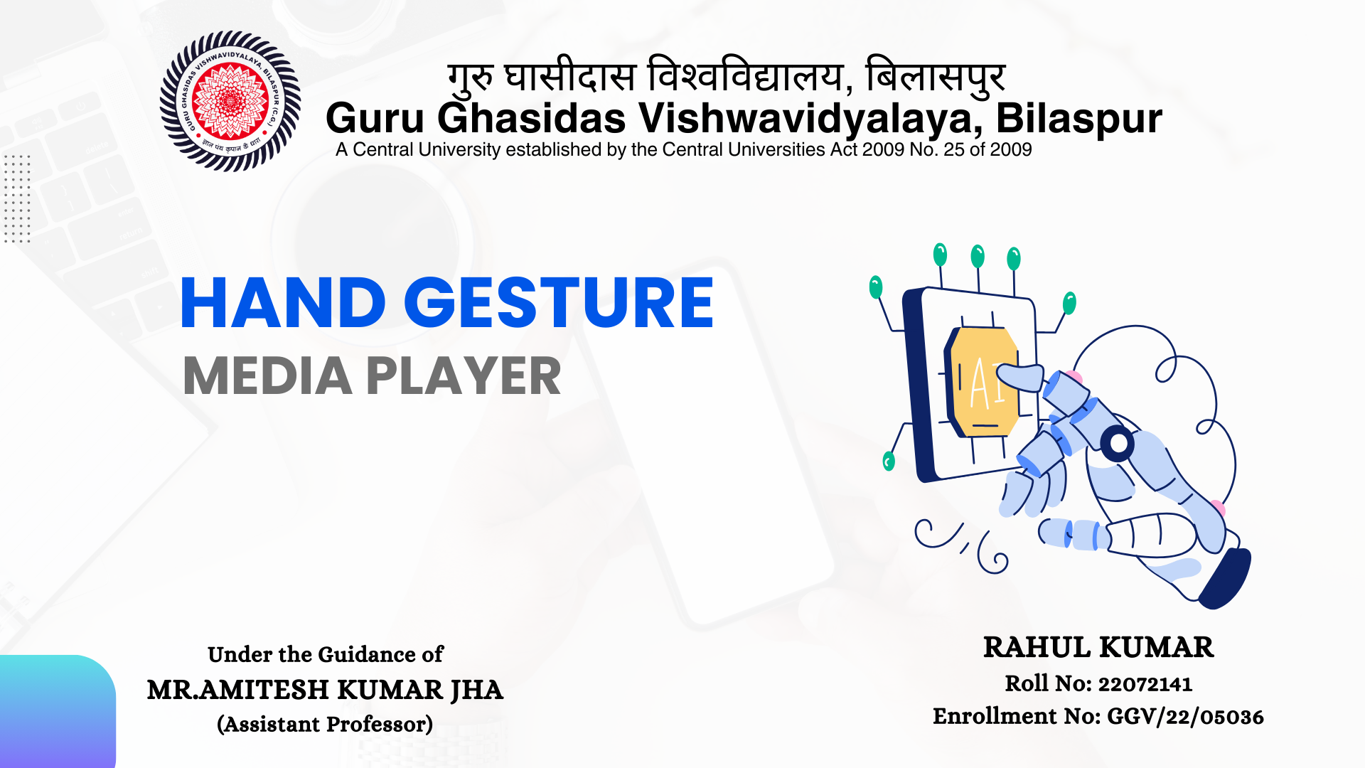
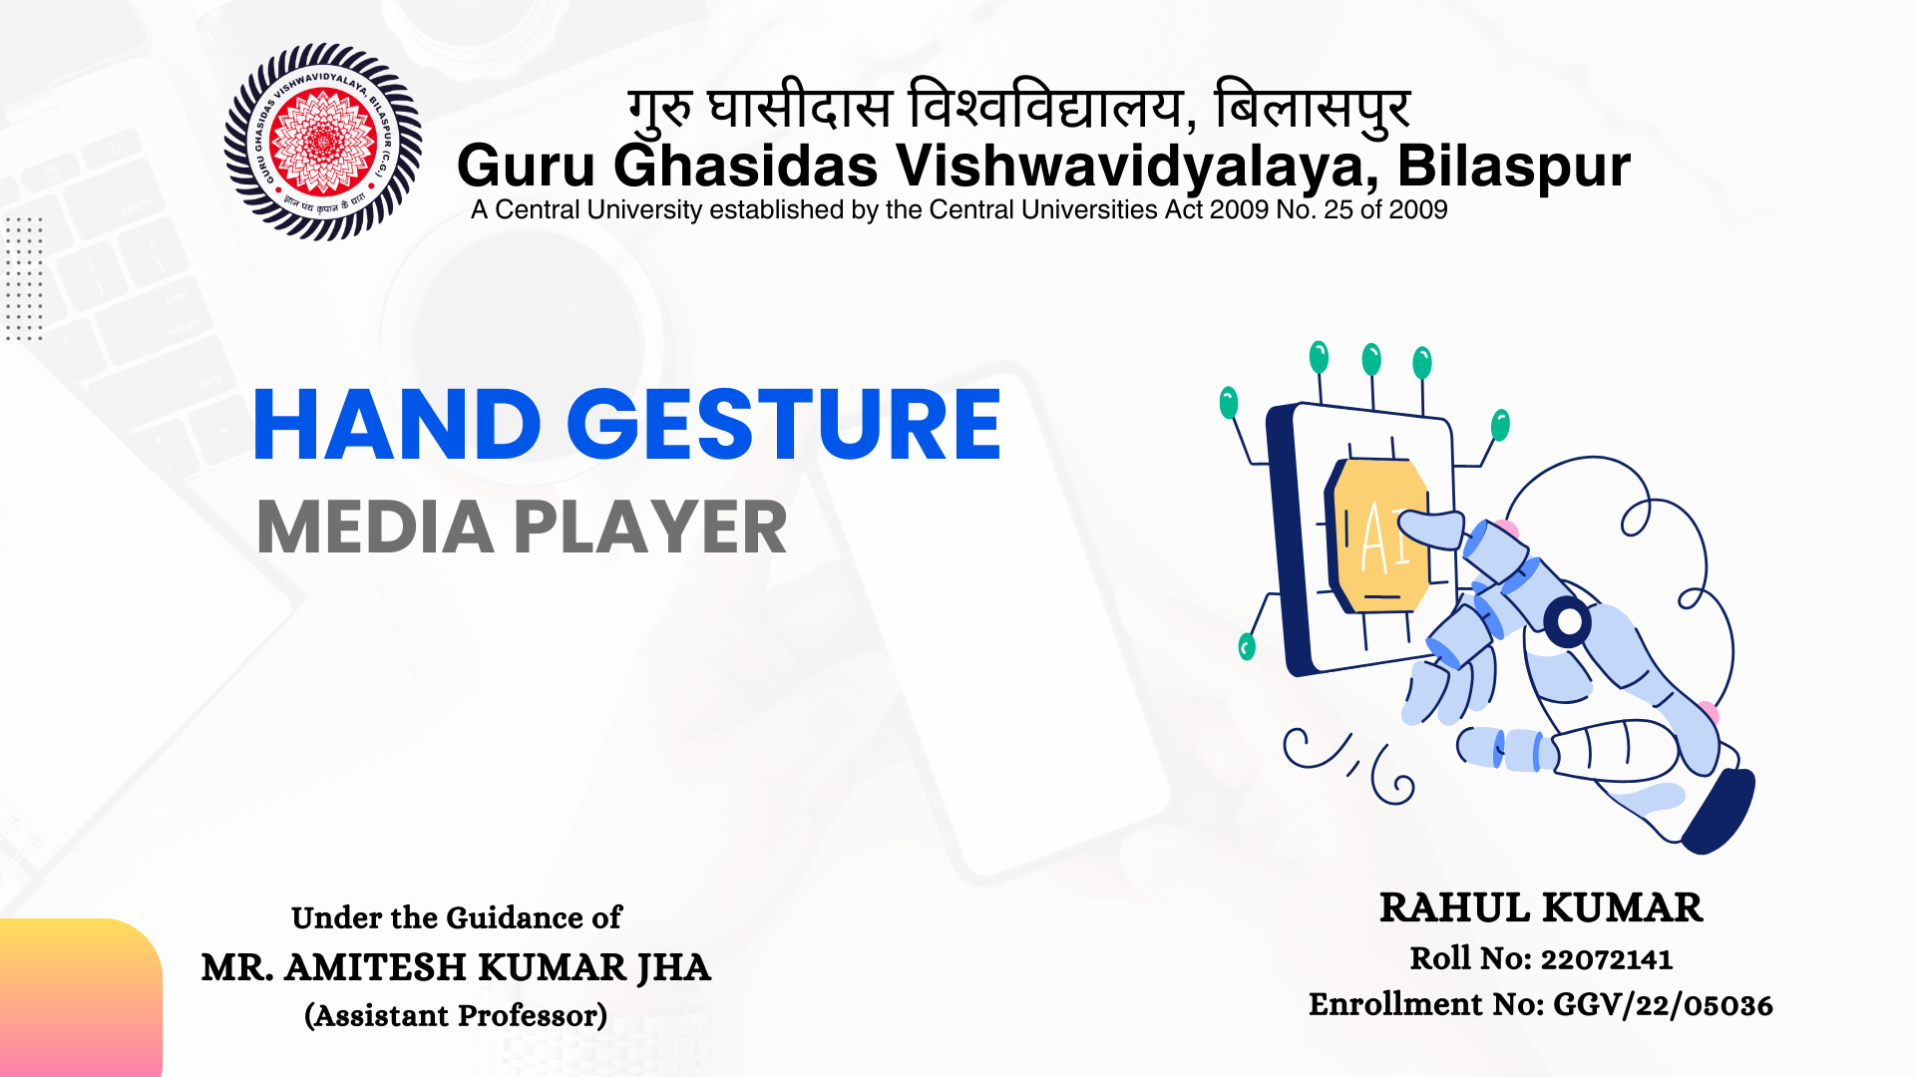

Slide 2

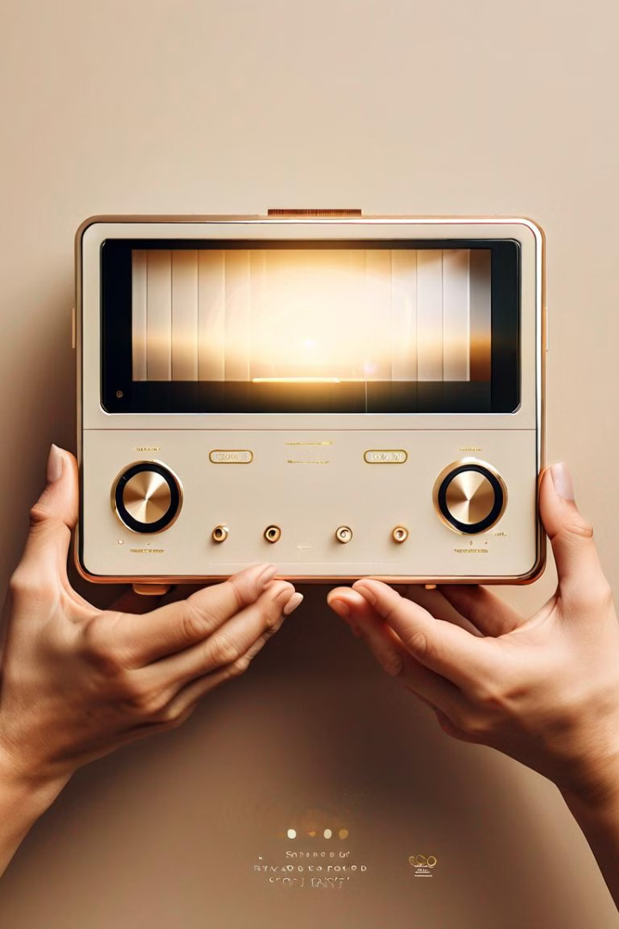
INTRODUCTION
Unlock a new era of hands-free media control with our innovative hand gesture-based media player. This revolutionary system leverages advanced computer vision and machine learning technologies to provide an intuitive and seamless user experience.

Slide 3

Current Problems with Traditional Media Players
1
Challenges with Traditional Controls
Traditional media control methods like remotes, keyboards, and touch screens can be awkward and hard to use.
2
Limited Mobility
Touch screens require physical contact, which can be inconvenient when hands are occupied or dirty.
3
Accessibility Challenges
Limited accessibility for individuals with physical disabilities, making it challenging for them to use these devices effectively.

Slide 4



TECHNOLOGY USED
Computer Vision (CV2)
Mediapipe
PyAutoGUI
Computer Vision (CV2) is an open-source library for real-time image and video processing, offering tools for tasks like object detection, face recognition, and image filtering.
MediaPipe is a cross-platform, open-source framework by Google that builds efficient machine learning pipelines for processing video and audio data. It offers ready-to-use solutions for tasks like face detection, hand tracking, and pose estimation.
PyAutoGUI is a Python library for automating mouse and keyboard actions, such as clicking, typing, and taking screenshots.

Slide 5


Advanced Hand Gesture Recognition
1
Gesture Detection
Our system uses computer vision and machine learning to accurately recognize a wide range of hand gestures in real-time.
2
Intuitive Control
Users can seamlessly control media playback functions such as play, pause, volume, and seek by performing natural hand motions.
3
Hands-free Interaction
The media player responds to user gestures, allowing for a truly hands-free, distraction-free experience.

Slide 6
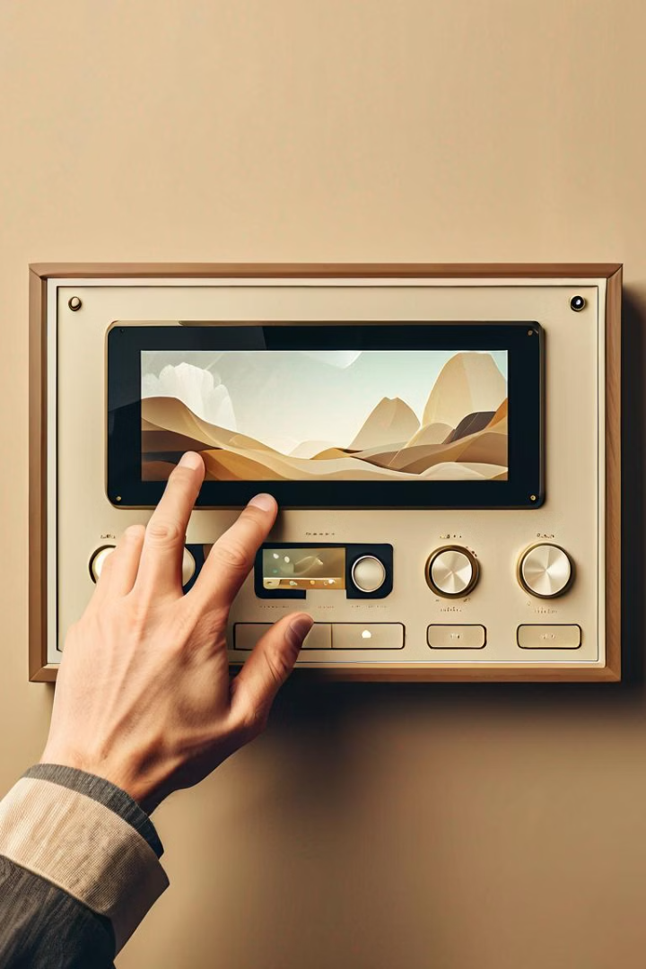



Hands-free Media Player Controls
Play/Pause
Raise your hand and make a simple open-close gesture to play or pause media.
Volume Control
Rotate your hand clockwise or counterclockwise to adjust the volume.
Seek Forward/Back
Swipe left or right to skip forward or backward in the media timeline.

Slide 7
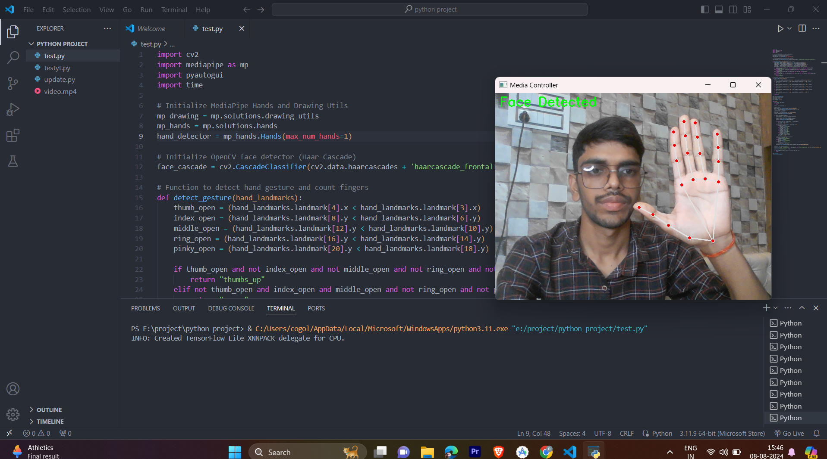
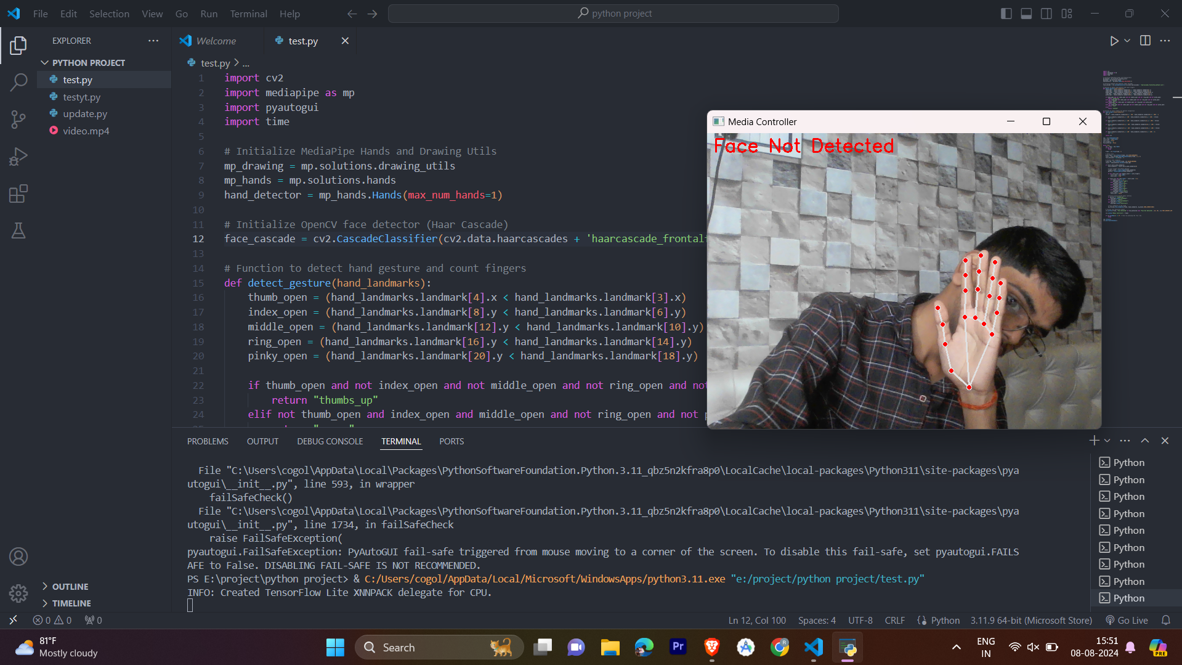
DEMO & SCREENSHOTS
Hand landmark with face detection
Hand landmark without face detection

Slide 8
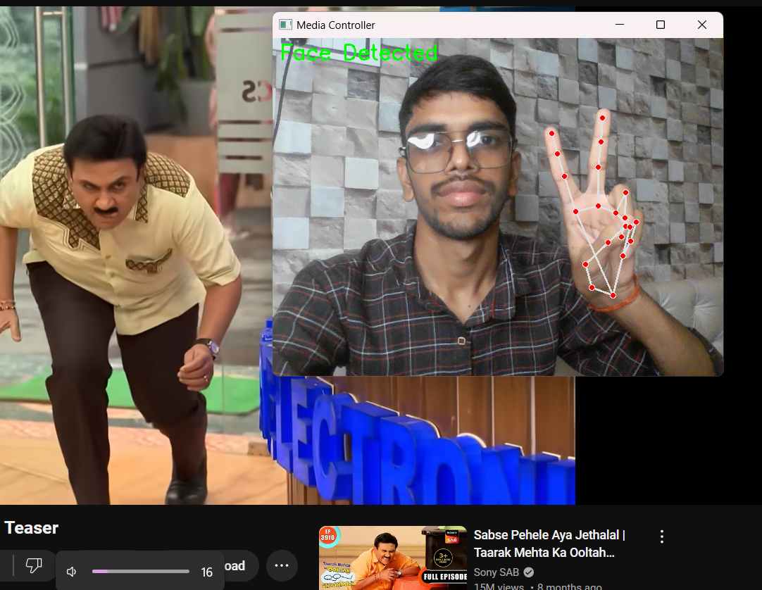
DEMO & SCREENSHOTS
Volume Controlling with hand (Decreasing )

Slide 9
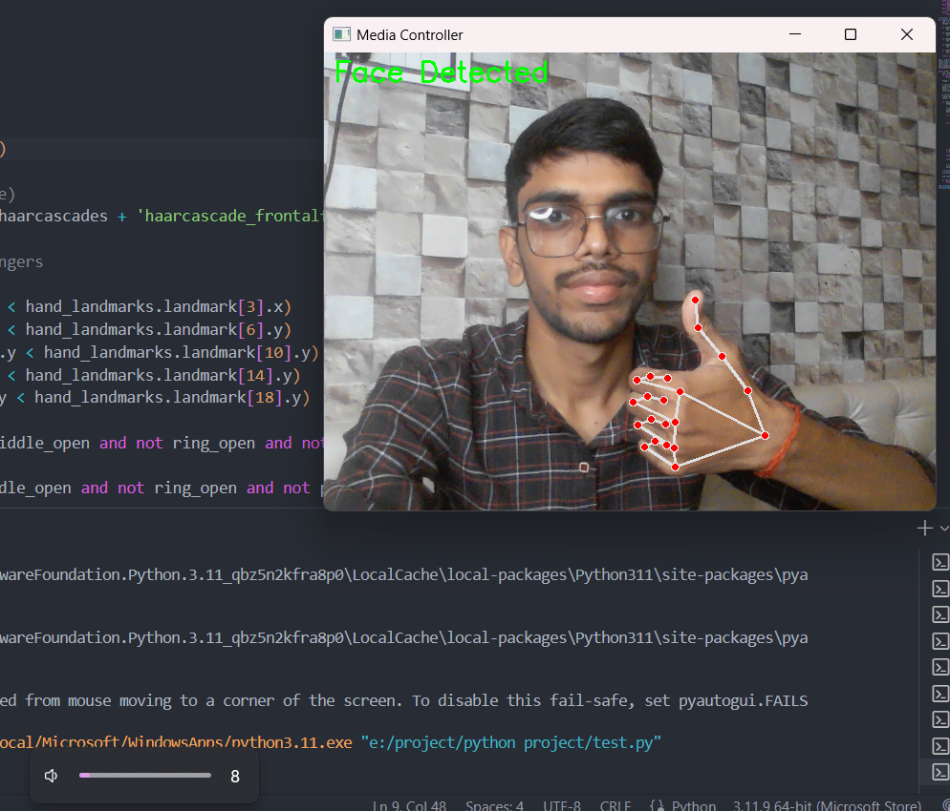
DEMO & SCREENSHOTS
Volume Controlling with hand (increasing )

Slide 10
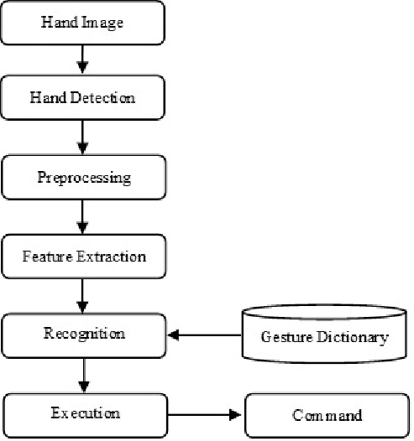
DATA FLOW DIAGRAM
This flowchart represents the process of hand gesture recognition. It begins with capturing a hand image, detecting the hand, and preprocessing the image to enhance quality. The system then extracts key features from the hand image, which are compared against a gesture dictionary to recognize the gesture. Finally, the recognized gesture is translated into a command, which the system executes, enabling gesture-based control.

Slide 11
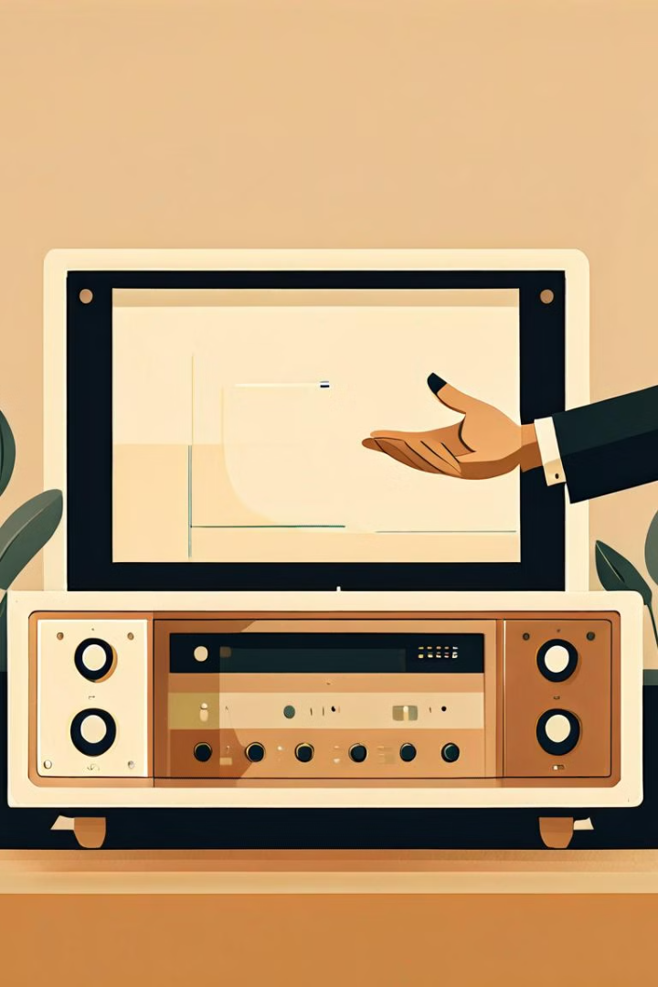
LIMITATIONS
1
Lighting Sensitivity
2
Complex Hand Poses
The hand gesture recognition may be affected by changes in lighting conditions.
Partially obstructed hands or complex hand poses can sometimes be misinterpreted.
3
Potential Latency
There may be a slight delay between the user's gesture and the system's response.

Slide 12
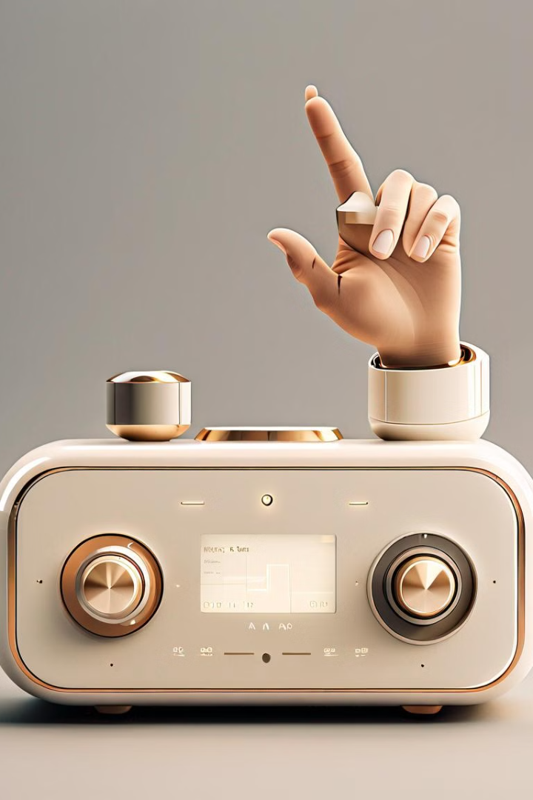



Future Enhancements and Improvements
Adaptive Lighting
Implement advanced lighting adjustment algorithms to ensure robust performance in various environments.
Improved Accuracy
Leverage the latest advancements in computer vision and machine learning to enhance gesture recognition accuracy.
Expanded Functionality
Explore integrating additional media controls, such as volume adjustment, playlist navigation, and settings customization.

Slide 13
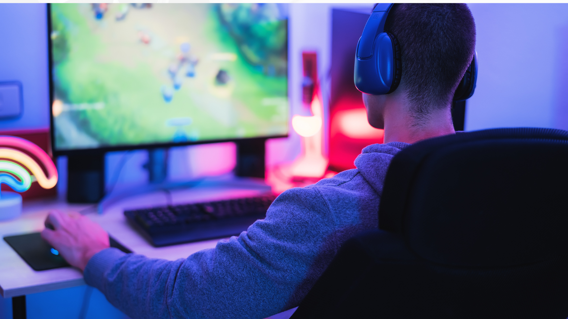
Summary and Conclusion
The "Hand Gesture Media Player" project developed a media control system using gesture recognition, enabling users to interact with media through simple hand movements. The Agile approach facilitated iterative development and continuous improvement, overcoming challenges like gesture accuracy and integration. The result is a user-friendly, hands-free solution that enhances both convenience and accessibility.
With hardware Controller
Without hardware Controller

Slide 14


